Slide 2
Telepractice in Schools: Skills, Solutions, and Evidence-Based Success
Andrea Lerma, MS, CCC-SLP
Alyssa Gilman, MS, CCC-SLP
Kendall Kordes, MS, CCC-SLP
Remy Hilchey, SLPD, CCC-SLP
Erica Ortiz, MCD, CCC-SLP
Notes:
Erica welcome/introductions

Slide 3
Disclosures
Andrea receives a salary as a full-time employee of Expressive Pathways Speech Therapy.
Alyssa receives a salary as a full-time employee of Expressable.
Kendall receives a salary as a full-time employee of Imagine Learning.
Remy receives a salary as a full-time employee of the University of St. Augustine for Health Sciences.
Erica receives a salary as a full-time employee of the University of St. Augustine for Health Sciences.
Notes:
Erica

Slide 4
Learning Objectives
Identify core skills and competencies required for effective school-based telepractice.
Develop actionable strategies to increase engagement and support from caregivers, facilitators, and school staff.
Apply practical solutions for delivering teletherapy to students with complex needs.
Evaluate research-based evidence supporting telepractice and formulate responses to common challenges and resistance in schools.
Notes:
Erica

Slide 5
Telepractice: Ideal vs. Reality
Ideal:
High visibility of all students and natural communication opportunities
Play-based, child-led, neuro-affirming therapy
Direct facilitation of materials and interactions
Reality:
Limited visual and auditory access (may not see or hear all students)
Preschool attention expectations: students move, enter/exit activities, and do not sit for extended periods
Heavy reliance on classroom staff to facilitate, interpret off-screen behavior, and support participation
Notes:
E: In many settings, not just teletherapy, we may have to grapple with the fact that the “reality” of our sessions may not match the “ideal.” That doesn’t mean that our work is ineffective.
Growth mindset, creativity, and collaboration with school staff/facilitators can lead to success.

Slide 6
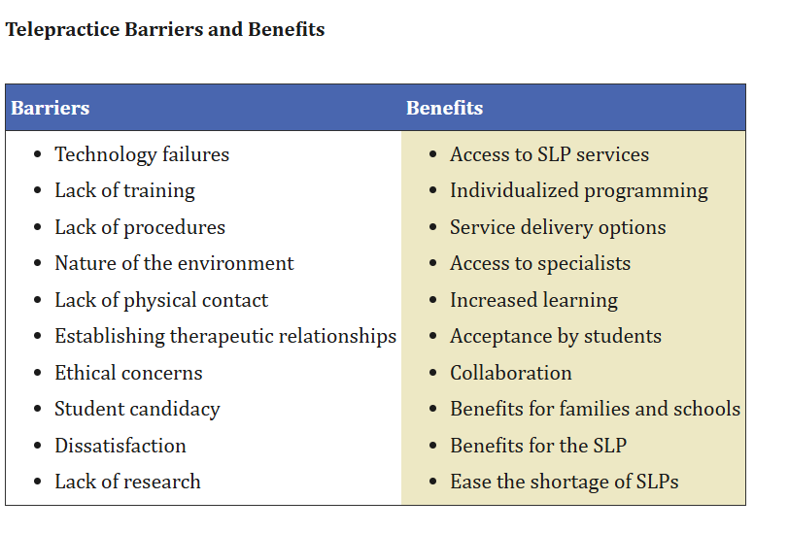
Telepractice Barriers and Benefits
(Tucker, 2012)
Notes:
E: ask for audience participation
Tucker, J.K. (2012). Perspectives of Speech-Language Pathologists on the Use of Telepractice in Schools: The Qualitative View. International Journal of Telerehabilitation, 4(2), 47–60. https://pmc.ncbi.nlm.nih.gov/articles/PMC4296828/

Slide 7
Core Telepractice Skills
Caregiver Coaching: Supporting teachers and paraprofessionals as co-facilitators of communication
Flexibility & Adaptation: Pivoting activities in real time based on classroom energy, behavior, and student interests
Clinical Agility: Quickly pulling up songs, visuals, communication boards, or alternative activities during sessions
Comfort with Controlled Chaos: Understanding that engagement may look different than in elementary or 1:1 teletherapy
Notes:
Alyssa: All of these skills are important for SLP’s in any setting, but may be even more important for SLP’s in teletherapy.

Slide 8
Pre-Session Preparation
Ongoing collaboration with the teacher around classroom themes or curriculum
Advance notice of activities (e.g., “We’re painting turkey feathers today—we’ll need ___”)
Shared visuals and communication boards
Coordination around materials and sensory activities
Notes:
Alyssa: Because the “reality” of teletherapy may be different from “ideal” therapy, A way to maximize effectiveness of sessions is to collaborate with teachers/support staff ahead of sessions.

Slide 9
When Prep Falls Apart
Sessions can feel chaotic
Requires on-the-fly adjustments (extended circle time, movement breaks, or sensory-based language modeling)
Example pivot: supporting and modeling during snack/meal time
Notes:
Alyssa: Regulate ourselves, regulate paraprofessional when things feel chaotic. Example situation
Examples of pivots:
setting the computer near a sensory table and modeling language using a communication board while students play
movement breaks (freeze dance)
modeling language during snack or sensory play

Slide 10
Facilitator Engagement and Collaboration
What Buy-In Looks Like:
Joy and laughter from adults—not just students
Staff actively modeling language and supporting communication
Carryover of strategies beyond the session
Notes:
Alyssa: Adult Coaching: Supporting teachers and paraprofessionals as co-facilitators of communication
Flexibility & Adaptation: Pivoting activities in real time based on classroom energy, behavior, and student interests
Clinical Agility: Quickly pulling up songs, visuals, communication boards, or alternative activities during sessions
Comfort with Controlled Chaos: Understanding that engagement may look different than 1:1 teletherapy

Slide 11
Facilitator Engagement and Collaboration
Coaching Strategies:
Priming staff before sessions (e.g., normalizing movement, join/exit/rejoin behaviors)
Naming clinical intentions out loud (e.g., focusing on wait time or following a student’s interest)
In-the-moment feedback (e.g., “That was a great prompt—let’s try it again and see what he can do independently.”)
Notes:
Alyssa

Slide 12
Pushback and Complex Cases
Sources of Pushback: Teachers (most common), occasionally families
Administrative Response: Generally supportive once the model is explained
Example of a Challenging Case:
Student rarely appeared on screen and engaged in pacing behavior
Progress was minimal and parent frustration increased
Solution: Increased collaboration with the teacher and reframing progress to highlight off-screen skill development
Notes:
We have all experienced pushback in teletherapy.
Pushback happens and we will talk about it more in the case studies as well, but getting out in front of it and educating admin and classroom staff.
Working in partnership and developing rapport with those in-person with students (teachers, aides) is so important.
Reframing progress can increase buy-in.

Slide 13
Measuring Effectiveness of Services
Progress Monitoring: Shows student progress, though data collection requires collaboration with classroom staff
Student Outcomes: Increased participation and engagement
Staff Outcomes: Strong carryover of strategies
Family Feedback: Generally positive; more acceptance than you would expect
Notes:
Alyssa: Family Feedback - are there times when families are not initially comfortable with telepractice? absolutely, but it’s far less than you would expect. Somethings we implement to combat that - trial period, increased communication with family/school/SLP, pictures and work samples to show progress

Slide 14
Case studies will illustrate:
Pre-session preparation
Session structure
Shared team language
Facilitator engagement and coaching
Progress measuring
Notes:
Erica 15 minutes per case study

Slide 15
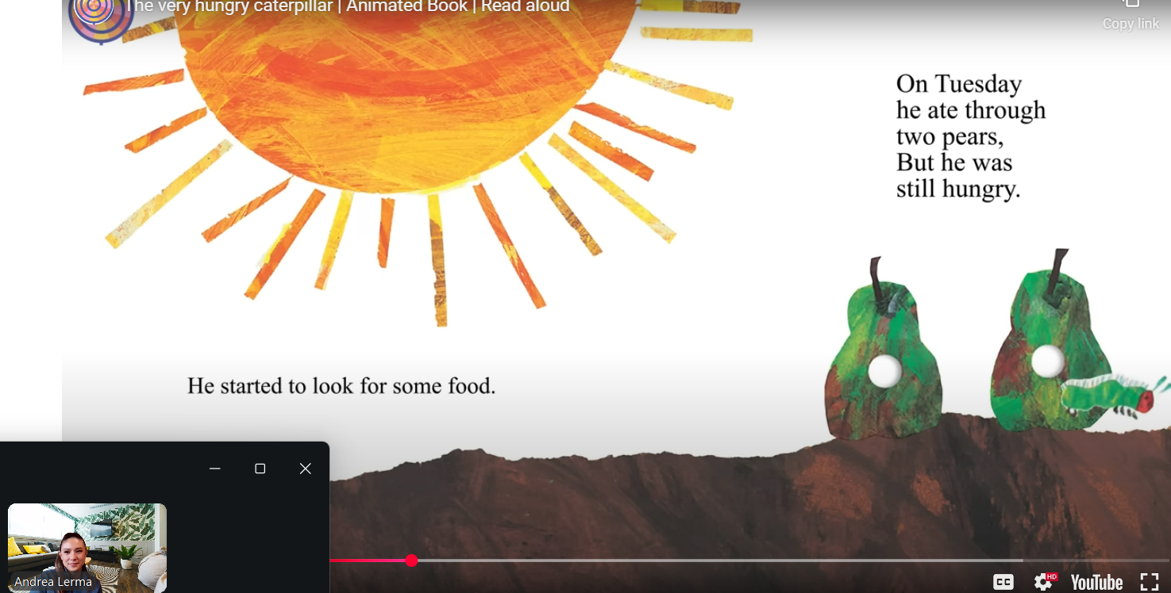
Case Study #1
AAC Telepractice Using The Very Hungry Caterpillar
AAC Telepractice in Schools: A Literacy-Based Case Study (TSHA) Handout - Click this link Handout
Notes:
Andrea

Slide 16
Student Profile
Student: Emma
Age: 6 years
Diagnosis: Cerebral Palsy
AAC: Dynavox with eye gaze
Service Model: Telehealth with in-person aide
Focus: Learning AAC navigation during shared activities
Notes:
Andrea

Slide 17
Communication Goals
Goal 1 – Core Vocabulary
Locate 3 familiar core words
Examples: eat, want, more
Moderate verbal/gestural support
4/5 opportunities
Goal 2 – WH Questions
Navigate AAC to answer “What” questions
Moderate verbal/gestural support
4/5 opportunities
Notes:
Andrea

Slide 18
Pre-Session Preparation
Collaborate with parents and teacher
Identify routines, motivators, and strengths
Establish shared communication goals
Include all team voices
Teacher
Aide
Caregivers
Specialists
Notes:
Andrea

Slide 19
Shared Team Language
“Our shared goal is independent communication across settings.”
“Let’s focus on what supports her best during transitions.”
Notes:
Andrea

Slide 20
Materials
The Very Hungry Caterpillar (animated video) The Very Hungry Caterpillar
Dynavox AAC device programmed with:
Core Vocabulary
eat, hungry, more, finished, big, small
Fringe Vocabulary
apple, pear, plum, strawberry
caterpillar, butterfly
days of the week
Notes:
Andrea

Slide 21
Session Structure
Watch short sections of the story
Model core words during food pages
Ask simple “What” questions
Provide extended wait time
Support initiation via eye gaze
Notes:
Andrea

Slide 22
AAC Targets During the Activity
Core word repetition (eat, more, want)
Navigation between core and fringe pages
Answering “What did he eat?”
Answering “What did he become?”
Notes:
Andrea

Slide 23
Facilitator Engagement
In-Person Aide Role
Support positioning and access
Interpret eye gaze selections
Reinforce wait time
Follow prompting hierarchy
Notes:
Remy
Quickly talk about her set up, her device was on a table mount,her first screen had her core vocabulary on a 15 icon/button grid, to access the “fringe vocabulary” a page was added to the food icon. let’s find food and that would open up to the various foods the caterpillar ate, let’s find the cupcake or what did he eat on Saturday. I am happy to talk more about the set during our q&a
Positioning is important with eye gaze because the student needs to be at angle where the device can calibrate the students eye movements and tell the difference between scanning and real selection again I am happy to go into this further during the q&a
“In this model, telepractice works because the primary intervention target is actually the adults in the room. Your role is to coach the in-person aide in real time—encouraging pauses, reducing verbal prompting, and resisting the urge to rescue. I use simple, actionable coaching language such as, ‘Let’s wait and see what she does,’ or ‘That pause gave her space—great support.This approach builds adult capacity and allows the student to take more communicative control.”

Slide 24
Consistency Across Settings
Use the same:
Prompting hierarchy
Wait time
Vocabulary locations
Share visuals and scripts
Align strategies at school and home
Notes:
“Progress increased when everyone used consistent strategies across settings.
This included using the same prompting hierarchy, the same vocabulary locations, and the same expectations for wait time. Consistency reduces cognitive load and supports motor planning, which is especially important for students using eye gaze access. From a district perspective, this supports fidelity of implementation and generalization of skills.”

Slide 25
Aligned Team Language
“Let’s use the same prompting hierarchy.”
“We’ll model the board the same way everywhere.”
Notes:
Remy here are some of the language you can use to help promote that consistency

Slide 26
Coaching in Real Time
Actionable Prompts
“Try pausing here.”
“Let’s see if she initiates.”
Strengths-Based Feedback
“That wait time gave her space—great support.”
“You modeled without taking over.”
Notes:
Remy here is some phrases you can use, that beyond good job, when the opportunities arises during the session the session

Slide 27
Building Trust With the Team
Trust supports AAC success
Consistent communication
Share wins—not only challenges
Examples…
“Here’s something that went well today…”
“Let’s check in about how this strategy is working.”
Notes:
Remy
making sure you have time to debrief afterwards grows and glows, problem solve, was that appropriate grid size, do we need to hide buttons or add more, how much modeling will she need moving forward , was she independent ect this what we will be documenting she independently navigated through the pages, she initiated conversation by selecting hello independently as a response
These responses will be what is documented in progress

Slide 28
Key Takeaways
AAC telepractice relies on adult coaching
Literacy activities support natural communication
Progress is built through:
Wait time
Consistency
Collaboration
Notes:
“Outcomes included increased AAC navigation, more intentional responses, and strong carryover by the adults supporting the student. The biggest takeaway is that telepractice is effective when we focus on connection rather than control. Literacy-based AAC activities create natural communication opportunities, and coaching adults allows those opportunities to extend beyond the therapy session.”

Slide 29
Bottom Line
Adults act as communication partners
Therapy focuses on modeling and facilitation
Support extends across environments
Notes:
“The bottom line is this: AAC telepractice works best when communication—not compliance—is the goal, and when we use our role to build capacity across the team rather than trying to manage every moment ourselves.”

Slide 30
Things to use today
Accessible Literacy Learning (ALL) Shared Reading Activity
TD Snap Core First Page Set
AAC Video Models: Prompting Hierarchy
Telepractice Justification (Texas School-Based)
Telepractice is an appropriate service delivery model when it supports access to the curriculum, allows
for collaboration with instructional staff, and results in measurable progress toward IEP goals. Services
are delivered in alignment with ASHA practice guidelines and Texas Education Agency expectations.
Notes:
Remy

Slide 31
Case Study #2 TELEPRACTICE IN A SELF-CONTAINED PRESCHOOL SPED CLASSROOM
Setting: Self-contained SPED preschool classroom (8–10 four-year-olds)
Eligibilities: Early childhood developmental delay/Non-Categorical, Autism, Multiple Disabilities
Primary Educational Needs: Functional communication, pre-academic skills, social-emotional/behavior, adaptive skills
Service Model: Whole-class push-in via Zoom
Technology: SLP projected on classroom smartboard
Notes:
This case study is all about the reality of being a school-based clinician.
Highlights from slide
So, Is a classroom of eight-ten 4 year olds ideal for teletherapy? No, but can it work and be effective? Absolutely.
In this case study,
Adult facilitation is NECESSARY
Frequency/Minutes: 90 minutes per month (equivalent to weekly 20–30 minutes of push-in services plus teacher consultation)
SLP Role: Sole SLP assigned to the classroom
Support: SLPA available for some (not all) classrooms
District Context: Large, geographically remote district with a strong telepractice presence due to staffing challenges (not a post-COVID model)

Slide 32
Session Setup
Still play-based, child-led, neuro-affirming therapy
Limited visual and auditory access (often cannot see or hear all students)
Preschool attention expectations: students move, enter/exit activities, and do not sit for extended periods
Heavy reliance on classroom staff to facilitate, collect data for off-screen behavior, and support participation
Notes:
Limited visual/aud access tends to be the biggest challenge.
This is often where telepractice gets misunderstood in school settings
—> communication access is the goal
If this were in person, adult facilitation would still be required—tele just makes it visible.

Slide 33
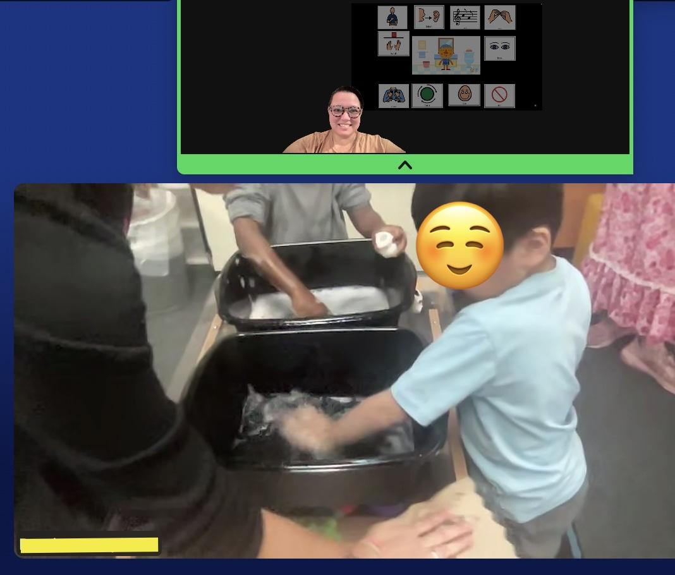
Pre-Session Prep
Teacher & SLP Collaboration Meetings/Office Hours
Pre-session Email
Align Themes
Consistent session structure
Notes:
I use CANVA frequently to lay out a session plan
Consistent session structure increases predictability not only for the students, but also the adults in the classroom
In the picture we’re doing a “handwashing” theme, it took a fair amount of collaboration to get the materials for session (do you have buckets? access to soap/water, etc), but then play was easy and lasted

Slide 34
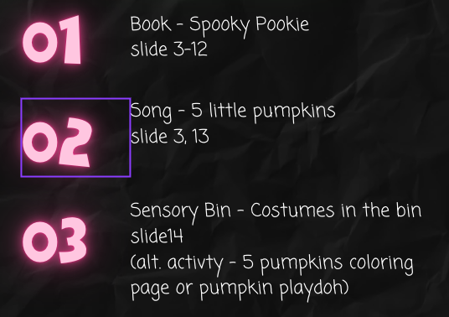
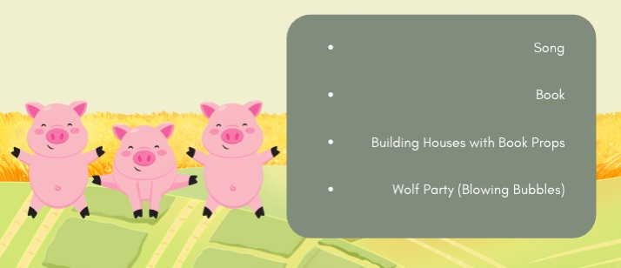
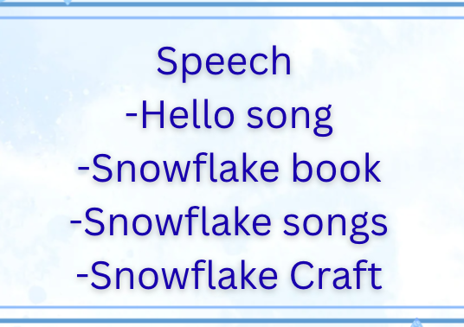
Typical Session Structure
Hello song
Short, adapted book with visual supports
Motor break (freeze dance or movement activity)
Hands-on activity targeting a core word (painting, coloring, play-dough, cooking, crafts, themed sensory table)
Paired with a communication board and language modeling
Goodbye song
Notes:
Again, consistency in structure is important for carry over and generalization, as well as buy-in

Slide 35
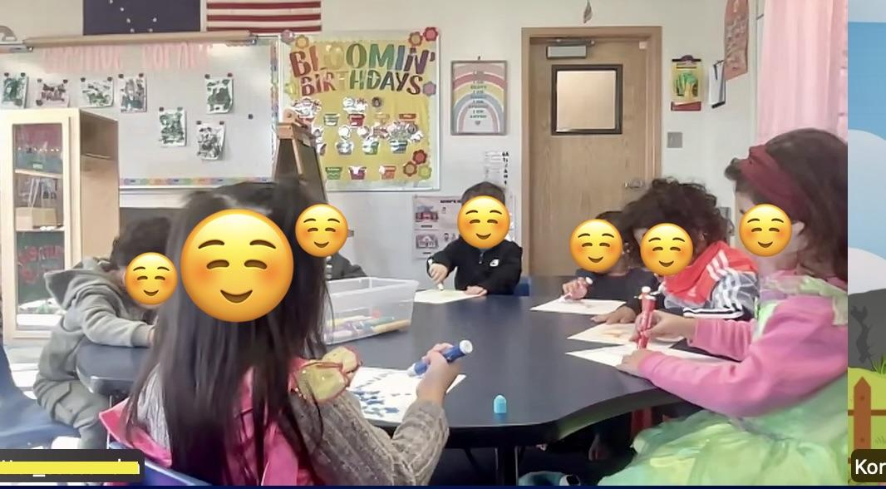
Materials
Activities That Work Especially Well:
Freeze dance
Themed sensory tables
Simple, repetitive crafts
Activities That Are Challenging:
Longer books or videos
Overly complex themes or activities
Notes:
In the picture we’re using dot markers to dot “Ten Apples Up On Top” after reading the book and singing an apple song

Slide 36
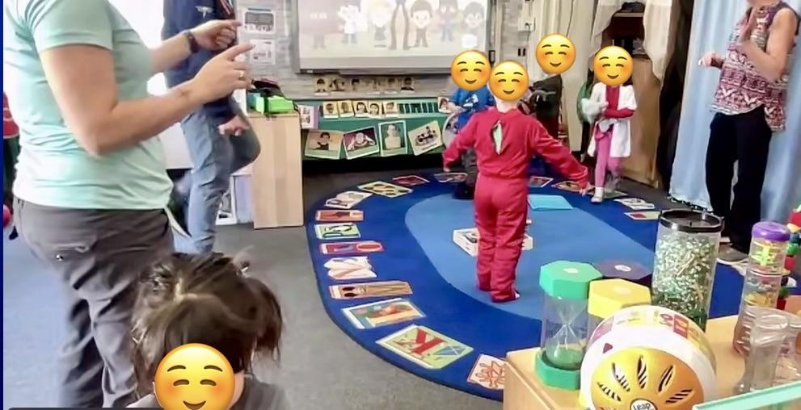
Shared Team Language
“I expect the kids to get up from the table - that’s ok”
“Our focus today is: ….” (giving wait time, letting the kids lead, modeling using communication boards)
“Look how beautifully X responded when you X”
Notes:
Priming staff before sessions (e.g., normalizing movement, join/exit/rejoin behaviors)
Naming clinical intentions out loud (e.g., focusing on wait time or following a student’s interest)
In-the-moment feedback (e.g., “That was a great prompt—let’s try it again and see what he can do independently.”)
Picture - incorporating movement during session. you can see that only 5/8 kids in this class are on screen and one is moving off. They leave and rejoin activities all the time (same as in person - the difference is that in person i can see them and where they go so in this model i rely on classroom staff. In the picture you can see the two classrooms staff and one of the adults is the PT so we are cotreating in that class as she has one student there.

Slide 37
Progress Monitoring/Measuring Effectiveness
Develop simple data sheets (think: Yes/No or tally mark) with goals so classroom staff can help you track
Increased collaboration with the teacher and reframing progress to highlight off-screen skill development
Notes:
Observers may believe the SLP is “just modeling” and not directly addressing goals - get out ahead of this and educate on modeling without expectations
Progress Monitoring: requires collaboration with classroom staff
Student Outcomes: Increased participation and engagement
Staff Outcomes: Strong carryover of strategies

Slide 38
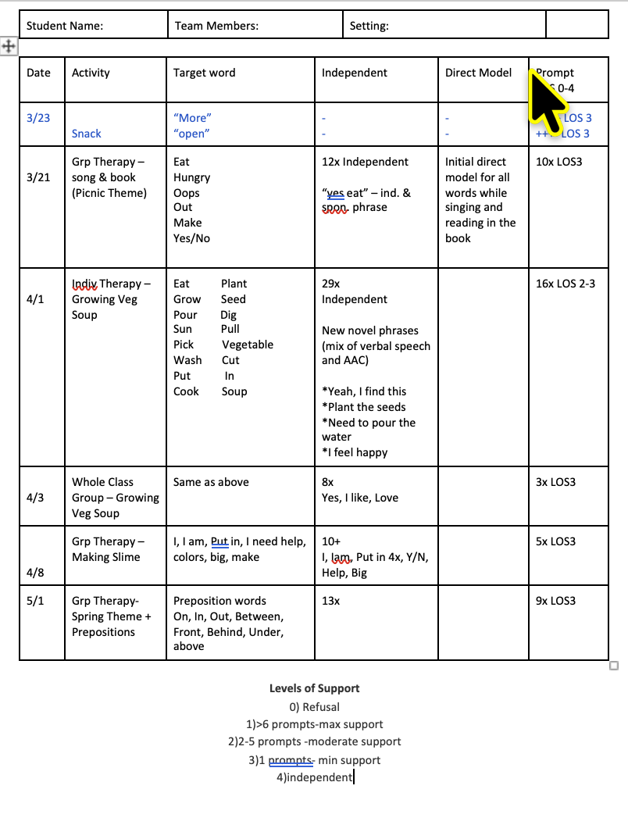
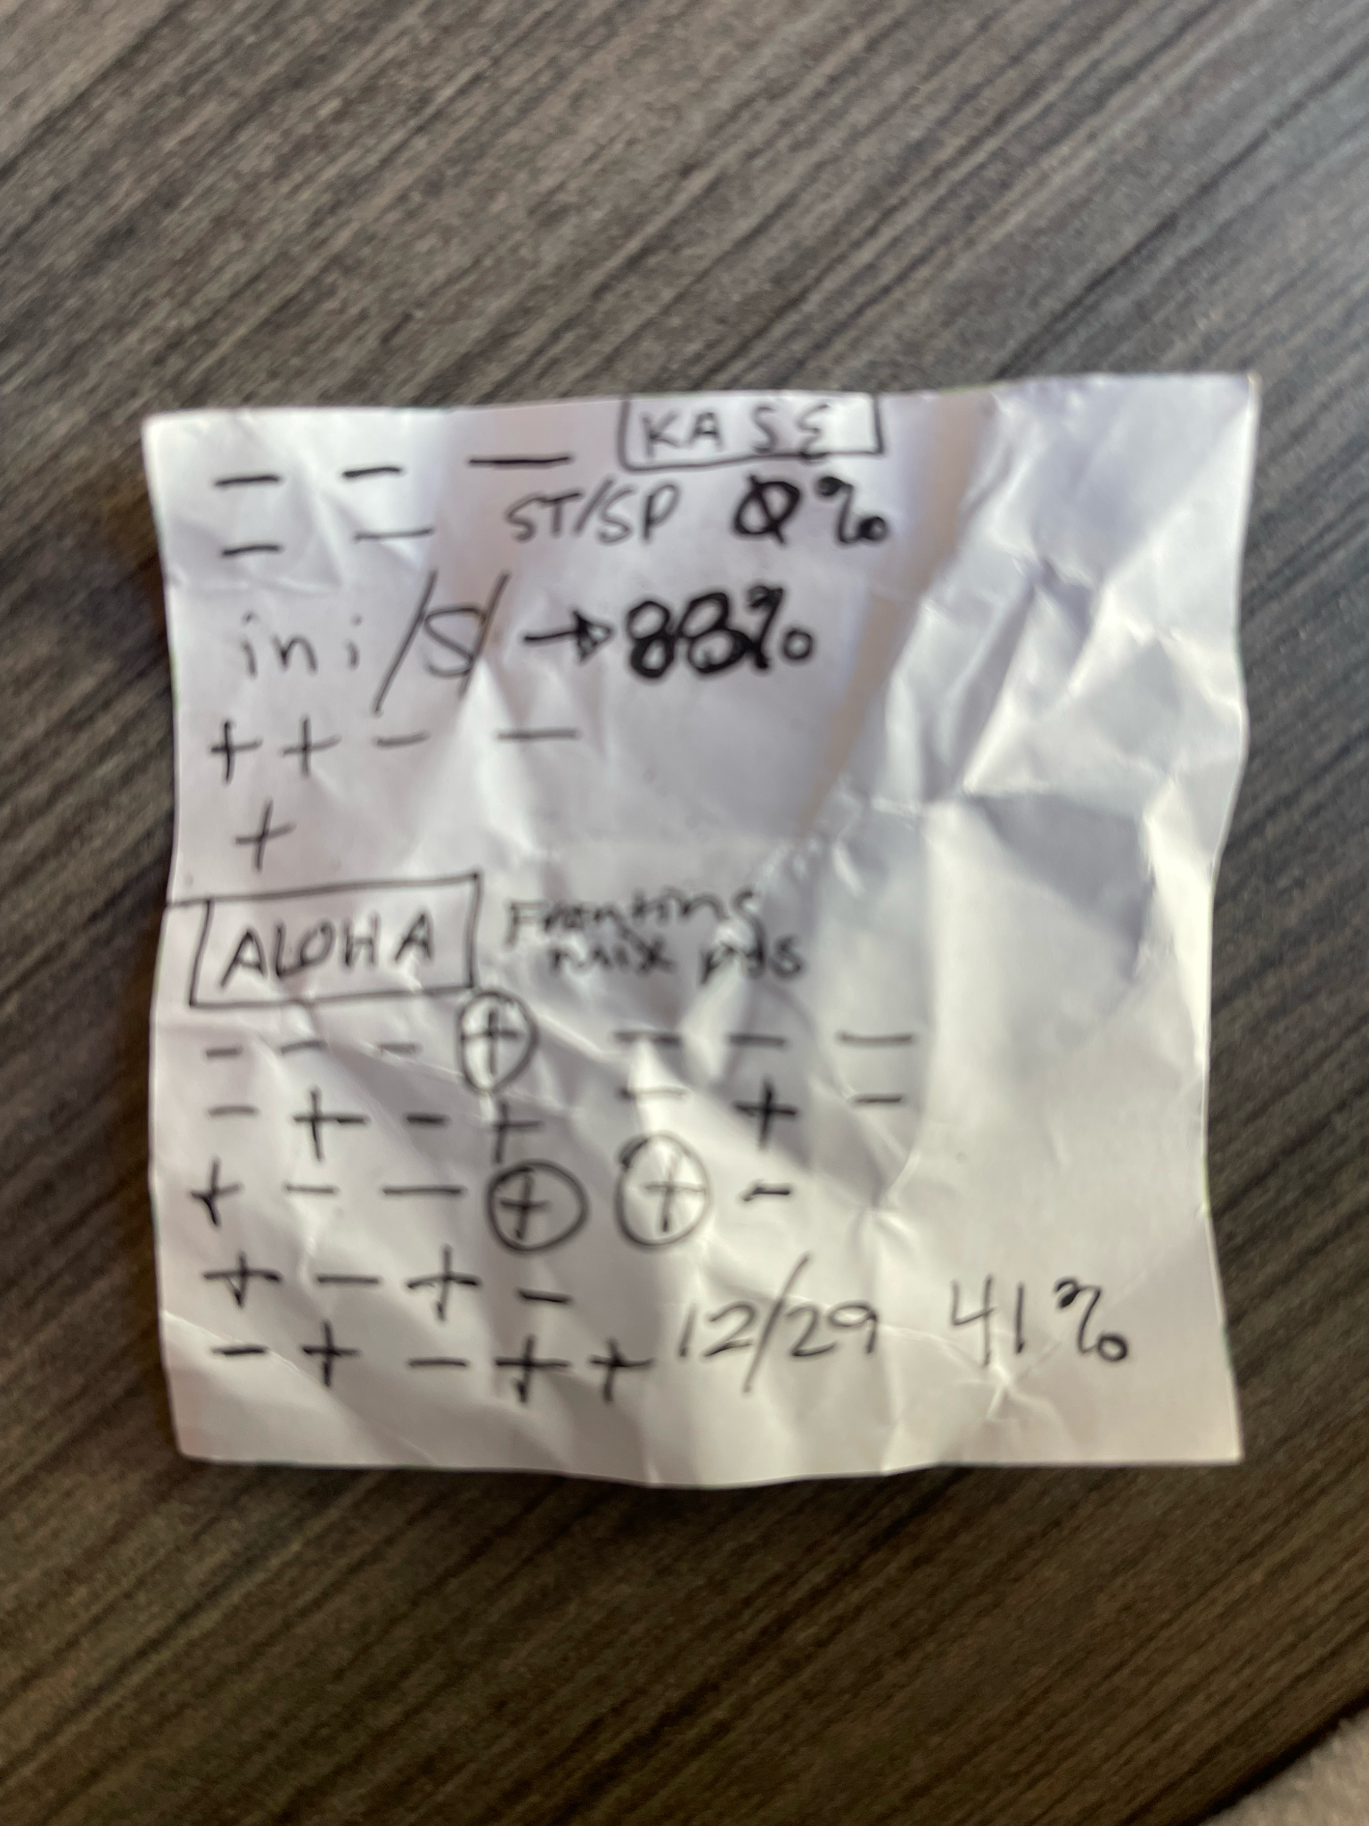
Data Collection
Examples
Notes:
Keep data collection simple

Slide 39
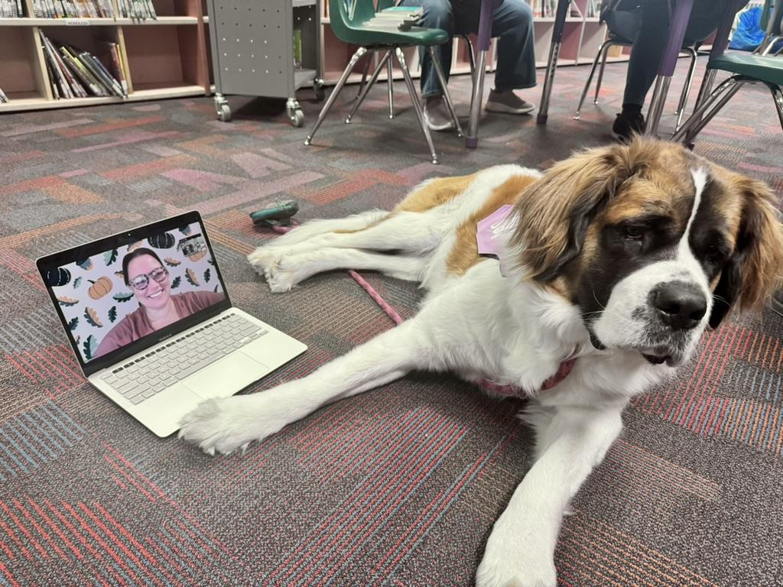
Integrate into the school
environment as much as possible
Notes:
You can still participate in school-wide meetings, be a part of their “sunshine committee”, mail cards to teachers, participate in parent teacher conferences,
Our School’s Therapy Dog, Eloise and I got some quality time on a RUFF DAY

Slide 40
Key Takeaways
Preschool telepractice requires:
High levels of flexibility
Strong collaboration and adult coaching
Creativity and comfort with movement and noise
Effectiveness is possible when the focus shifts from control to connection and facilitation
Notes:
Preschool teletherapy works best when lean into what telepractice uniquely allows → real-time coaching, adaptability, and collaborative service delivery.

Slide 41

Audience survey
Notes:
Survey: to keep the conversation going. What are your favorite telehealth resources and activities, but also your biggest challenges in telepractice? This will help us to grow a collaborative community. Q and A time

Slide 42
References
Tucker, J.K. (2012). Perspectives of Speech-Language Pathologists on the Use of Telepractice in Schools: The Qualitative View. International Journal of Telerehabilitation, 4(2), 47–60. https://pmc.ncbi.nlm.nih.gov/articles/PMC4296828/
Hall-Mills, S., Johnson, L., Gross, M., Latham, D., & Everhart, N. (2022). Providing Telepractice in Schools During a Pandemic: The Experiences and Perspectives of Speech-Language Pathologists. Language, Speech, and Hearing Services in Schools, 53(2), 290-306. https://doi.org/10.1044/2021_LSHSS-21-00023
Wales, D., Skinner, L., & Hayman, M. (2017). The Efficacy of Telehealth-Delivered Speech and Language Intervention for Primary School-Age Children: A Systematic Review. International Journal of Telerehabilitation, 9(1), 55–70. https://doi.org/10.5195/ijt.2017.6219
Grogan-Johnson, S., Alvares, R., Rowan, L., & Creaghead, N. (2010). A pilot study comparing the effectiveness of speech language therapy provided by telemedicine with conventional on-site therapy. Journal of Telemedicine and Telecare. https://doi.org/10.1258/jtt.2009.090608
Roth, B., Musaji, I., & Self, T. (2025). Telepractice Perceptions and Needs of Kansas School-Based Speech-Language Pathologists: A Cross-Sectional Survey Study. Perspectives of the ASHA Special Interest Groups, 10(5). 1595-1614. https://doi.org/10.1044/2025_PERSP-24-00286
ASHA Evidence Maps: Telepractice in Schools. https://apps.asha.org/EvidenceMaps/Articles/ArticleSummary/6b925074-e930-f011-8159-005056834e2b
ASHA Practice Portal: Telepractice. https://www.asha.org/practice-portal/professional-issues/telepractice/

